Slide 1

Credit Prediction
12.2.24
Final In-Class Presentation
DSCI 451
Nicolas Kozachuk

Slide 2
Agenda
DSCI 451 Presentation
1.
Project 1 Overview
2.
Values Critique
3.
Fairness Critique
4.
Revisions
5.
Revision Results

Slide 3
Agenda
DSCI 451 Presentation
1.
Project 1 Overview
2.
Values Critique
3.
Fairness Critique
4.
Revisions
5.
Revision Results

Slide 4
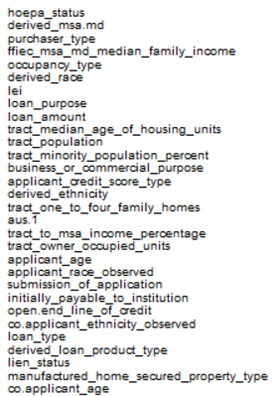

Project 1 Model
Features Used
Random Forest
10-Fold Cross Validation
Initially ~294,000 data entries
After removing empty feature columns and then rows with missing entries, ~227,000 entries
Number of trees = 10
Difference in accuracy between 10 and 100 trees was negligible, but 100 trees runtime was significantly longer

Slide 5
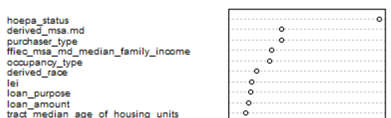
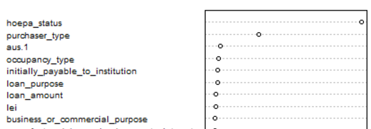
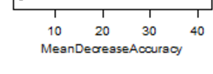

Project 1 Results
Action Taken Truths
10-Fold Cross Validation
Precision: 0.992
Recall: 0.989
F1-Score: 0.991
Overall Accuracy: 98.87%
 | 1 | 3
1 | 161,271 | 1,184
3 | 1,692 | 63,007
Action Taken
Prediction

Slide 6
Agenda
DSCI 451 Presentation
1.
Project 1 Overview
2.
Values Critique
3.
Fairness Critique
4.
Revisions
5.
Revision Results

Slide 7
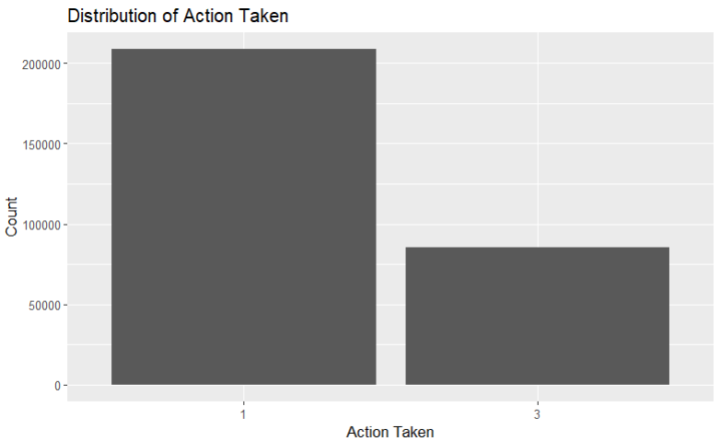
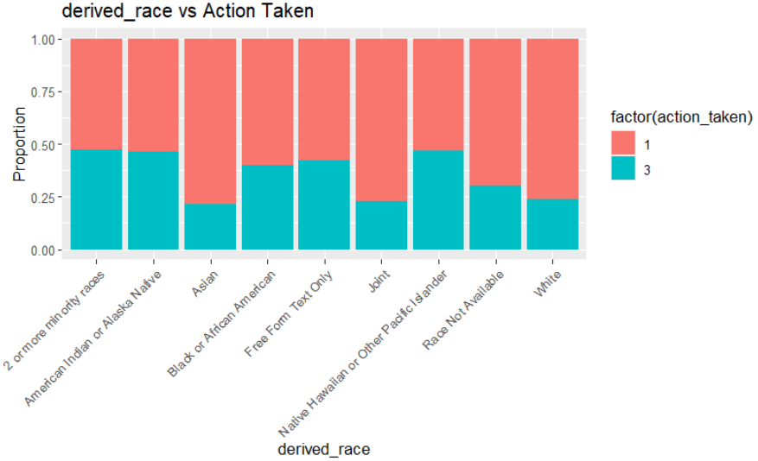
Values Critique
Deeper analysis of data determined there was a highly uneven distribution of denied vs approved loans
Explored categorical variables of race, sex, ethnicity and hoepa status
Removed columns with more than 50% missing data
Selected features to be used based on what was thought to be most important
Loan amount, income, property value, hoepa status, lien status, loan type, loan purpose, occupancy type, and applicant credit score type
Increase number of trees from 10 to 100

Slide 8
Agenda
DSCI 451 Presentation
1.
Project 1 Overview
2.
Values Critique
3.
Fairness Critique
4.
Revisions
5.
Revision Results

Slide 9
Fairness Critique
Demographic parity was used to find fairness by checking for equal approval rates amongst races and sex
It showed large racial disparities as white and asians were approved for loans at a higher rate, and a slight disparity in favor of men vs women
Disparate Impact Metric was used to find fairness amongst races and sex in a less strict manner due to a more lenient threshold
Found significant racial bias, but balanced rates across sex groups
Equalized Odds checks for equal True Positive Rates and False Positive Rates across groups
Shows slight disparities across gender
Approval by Race
Asian: 77.37%
White: 76.45%
Black: 59.60%
Hawaiian: 48.08%
Approval by Sex
Male: 69.80%
Femail: 66.37%
Race: 0.6214
Sex: 0.9508
Difference in TPR(M vs F): 0.0030
Difference in FPR(M vs F): 0.0042

Slide 10
Agenda
DSCI 451 Presentation
1.
Project 1 Overview
2.
Values Critique
3.
Fairness Critique
4.
Revisions
5.
Revision Results

Slide 11
Revisions
Remove columns with >50% missing data instead of removing entries
Retains more data as entry rows may be removed due to NA entries for unused
Selected features to use - Used features from peer values analysis(1-9) + important ones found from my project 1(10-14) and used no features with protected classes
1. Loan_amount
2. Income
3. Property value
4. Hoepa status - Whether the loan is a high-cost mortgage
5. Lien status - legal claim a lender or creditor has on a property until a debt is paid off
6. loan_type
7. loan_purpose
8. occupancy_type
9. Applicant credit score type
10. purchaser_type - Type of entity purchasing a covered loan from the institution
11. lei - A financial institution’s Legal Entity Identifier
12. derived_msa.md - The 5 digit derived MSA or MD code.
13. ffiec_msa_md_median_family_income - FFIEC Median family income in dollars for the MSA/MD
14.business_or_commercial_purpose
Notes:
1.Loan_amount - The amount of the covered loan, or the amount applied for
2.Income - The gross annual income, in thousands of dollars, relied on in making the credit decision, or if a credit decision was not made, the gross annual income relied on in processing the application
3.Property value - The value of the property securing the covered loan or, in the case of an application, proposed to secure the covered loan, relied on in making the credit decision
4.Hoepa status - Whether the covered loan is a high-cost mortgage
5.Lien status - Lien status of the property securing the covered loan, or in the case of an application, proposed to secure the covered loan
6.loan_type - The type of covered loan or application
7.loan_purpose - The purpose of covered loan or application
8.occupancy_type - Occupancy type for the dwelling
9.Applicant credit score type - The name and version of the credit scoring model used to generate the credit score, or scores, relied on in making the credit decision
10.purchaser_type - Type of entity purchasing a covered loan from the institution
11.lei - A financial institution’s Legal Entity Identifier
12.derived_msa.md - The 5 digit derived MSA (metropolitan statistical area) or MD (metropolitan division) code. An MSA/MD is an area that has at least one urbanized area of 50,000 or more population.
13.ffiec_msa_md_median_family_income - FFIEC Median family income in dollars for the MSA/MD in which the tract is located (adjusted annually by FFIEC)
14.business_or_commercial_purpose - Whether the covered loan or application is primarily for a business or commercial purpose

Slide 12
Agenda
DSCI 451 Presentation
1.
Project 1 Overview
2.
Values Critique
3.
Fairness Critique
4.
Revisions
5.
Revision Results

Slide 13
Revision Results
~284,000 entries used
Improved accuracy from 97.73% to 98.59%
With race and gender no longer being used as features, there are no protected classes that could result in unfairness, so the model is fair
Action Taken Truths
10-Fold Cross Validation
Precision: 0.992
Recall: 0.990
F1-Score: 0.991
Overall Accuracy: 98.59%
 | 1 | 3
1 | 205,410 | 1,539
3 | 2,472 | 74,991
Action Taken
Prediction
Notes:
1.Loan_amount - The amount of the covered loan, or the amount applied for
2.Income - The gross annual income, in thousands of dollars, relied on in making the credit decision, or if a credit decision was not made, the gross annual income relied on in processing the application
3.Property value - The value of the property securing the covered loan or, in the case of an application, proposed to secure the covered loan, relied on in making the credit decision
4.Hoepa status - Whether the covered loan is a high-cost mortgage
5.Lien status - Lien status of the property securing the covered loan, or in the case of an application, proposed to secure the covered loan
6.loan_type - The type of covered loan or application
7.loan_purpose - The purpose of covered loan or application
8.occupancy_type - Occupancy type for the dwelling
9.Applicant credit score type - The name and version of the credit scoring model used to generate the credit score, or scores, relied on in making the credit decision
10.purchaser_type - Type of entity purchasing a covered loan from the institution
11.lei - A financial institution’s Legal Entity Identifier
12.derived_msa.md - The 5 digit derived MSA (metropolitan statistical area) or MD (metropolitan division) code. An MSA/MD is an area that has at least one urbanized area of 50,000 or more population.
13.ffiec_msa_md_median_family_income - FFIEC Median family income in dollars for the MSA/MD in which the tract is located (adjusted annually by FFIEC)
14.business_or_commercial_purpose - Whether the covered loan or application is primarily for a business or commercial purpose

